Slide 1
Agent Framework
Part 2 - Orchestration
Mike Yeager
CEO CODE Consulting

Slide 2

Mike Yeager
CEO CODE Consulting
Senior developer and manager
AI project lead
Writer & speaker
MS Azure contributor
myeager@codegroup.io

Slide 3


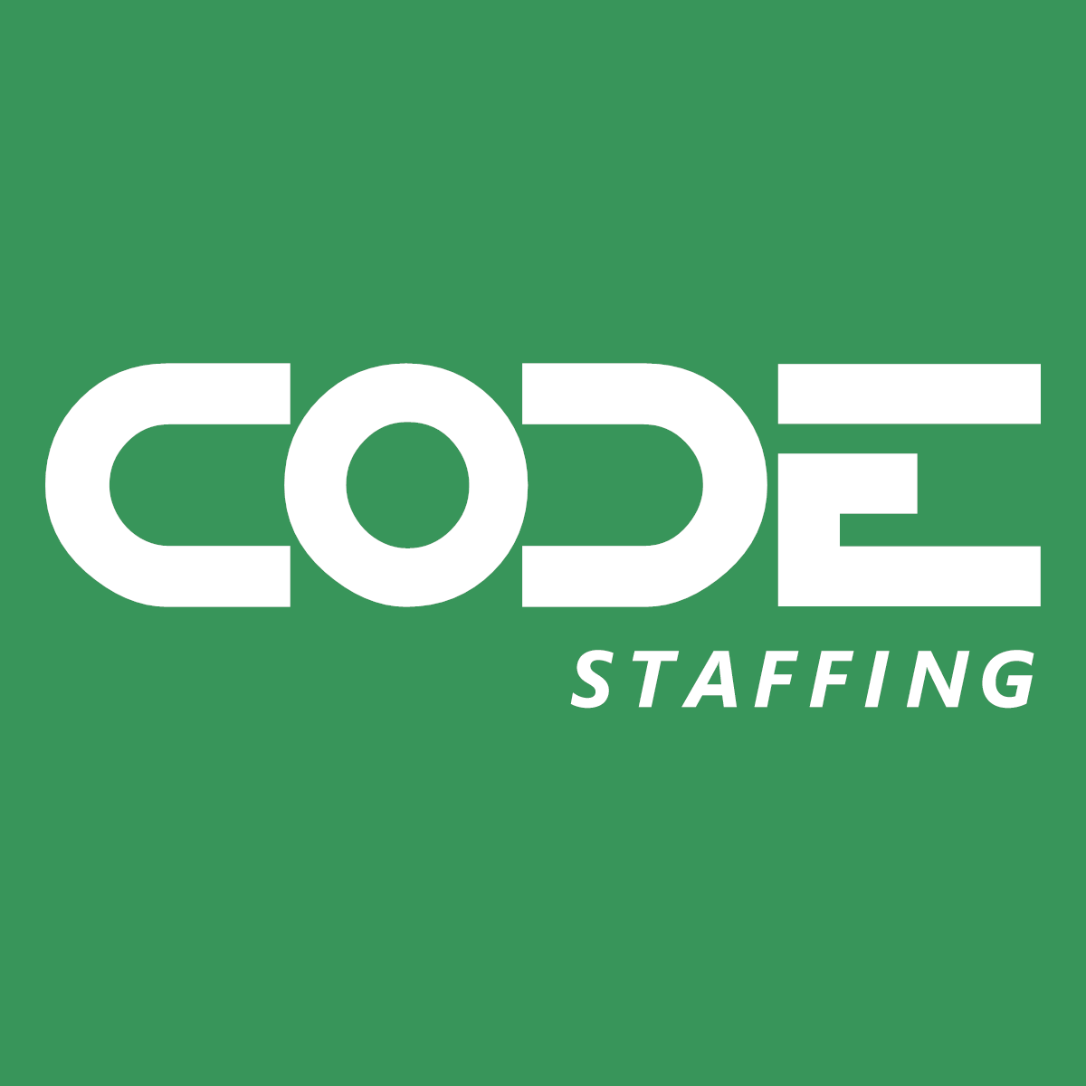



Slide 4






About CODE Consulting
Custom software development
(web, mobile, desktop and cloud platform apps)
Copilot development, AI, GPT, Azure OpenAI,
machine learning, and more…
Project rescue (cloud, web, mobile, Windows, …)
App modernization (primarily Visual FoxPro)
Support & maintenance for existing applications

Slide 5
Agenda
Brief review of agents in AF
NuGet packages
Orchestrations
Manual workflows
Demo
Q & A

Slide 6
What are Agents Anyway?
Agents have goals
Agents autonomously pursue goals (tasks are handed off to agents)
Agents can be given:
  Tools
  Memory
  Reasoning/Deep Reasoning
  Planning/Orchestration/Workflows
Agents can have sub-agents
Specialized Agents can be more effective than a single, generalized chat session

Slide 7
Agent Fwk - Why do I care
Coding to specific APIs locks you in
Different providers (both cloud and local) provide different feature sets
You have to learn different APIs for different tasks
It’s tedious to write low level code for things like streaming responses or maintaining chat history
You can use things like caching and telemetry fairly easily

Slide 8
What is Microsoft.Agents.AI?
Successor to Semantic Kernel and AutoGen (High Level)
  Implements abstractions & providers in Microsoft.Extensions.AI
  .NET and Python
  Structured output
  Workflows
  Background responses (long running workflows)
When available:
  Code interpreters
  File search
  Integrations (M365, Azure Functions, A2A Hosting, Dev UI, Purview, etc.)

Slide 9
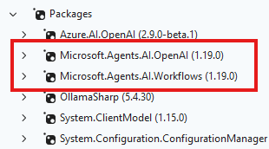
NuGet Packages

Slide 10
Orchestrations
Orchestration are canned workflows that allow you to orchestrate multiple agents in a single conversation, and define how messages should be passed between them.

Slide 11
Orchestrations in the box
Sequential
Concurrent
Handoff - Agents decide if they hand off to another agent
Group Chat – Manager decides which agent goes next
Magentic – Magic!, context shared across agents, plans, manages

Slide 12
Executors, Edges, and Message Flows
Custom workflows require you to define your executors, edges and message flows, giving you full control over the flow of the conversation and how agents interact with each other, but also require more work to set up.

Slide 13
Executors
Typed message processors
Can be an AI Agent or custom code
Custom executors are ‘hooks’ in the message flows

Slide 14
Edges
Route messages between executors
Types
  Direct
  Conditional
  Switch-case
  Fan-out
  Fan-in

Slide 15
Message Flows
Messages are strongly typed
Messages are Sent or Handled

Slide 16
Demo

Slide 17


Free Subscription
The leading software development magazine,
written by expert developers for developers.
All registered attendees will receive a
free digital subscription to CODE Magazine!
Share this link to our free subscription:

Slide 18
Please take the survey

Slide 19

AI Executive Briefings
Check out our new Executive Briefing offer!
We can help with your AI needs
What does AI mean for you?
codemag.com/AI
codemag.com/ExecutiveBriefing

Slide 20

CODE Staffing
Disrupting the world of staffing!
Giving our customers the ability to have
staff on par with Silicon Valley companies …
… and our employees a work environment
in a bleeding-edge tech company with
the industry leading benefits!
codestaffing.com

Slide 21

WE NEED YOU!
codestaffing.com/careers

Slide 22

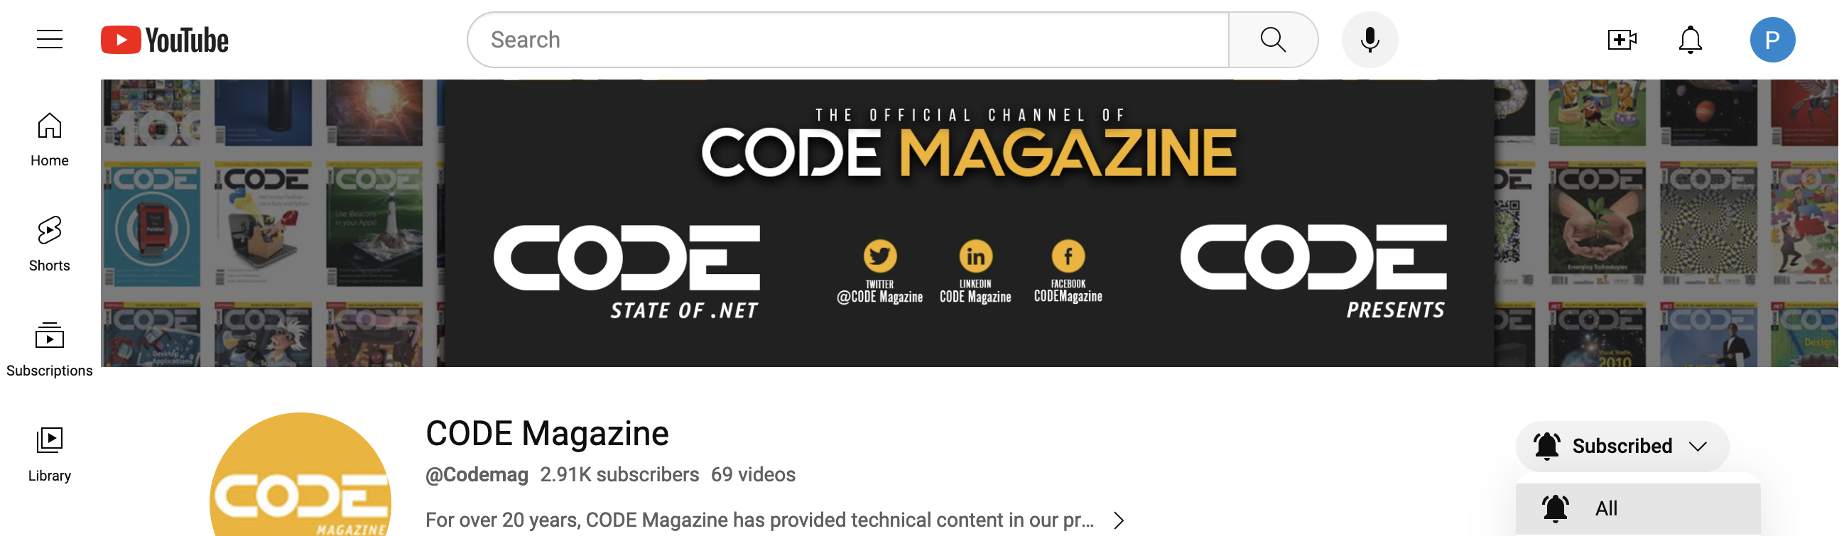
Subscribe and “ring that bell”
to never miss any of our content!
youtube.com/codemag

Slide 23
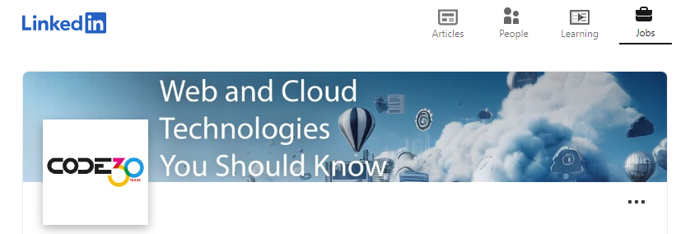

Be the first to know about our webinars, workshops, and live events!
Follow us!
www.linkedin.com/company/code-magazine

Slide 24
Q&A
Contact us with questions!
CODE Contact
codemag.com
info@codemag.com
facebook.com/codemag
twitter.com/codemagazine
Presenter Contact
myeager@codegroup.io

